Slide 1
Applications Instruction Set

Slide 2
Applications Instruction Set
The instructions are grouped by categories of related functions.
Data Movement Instructions
Binary Arithmetic Instructions
Decimal Arithmetic Instructions
Logical Instructions
Control Transfer Instructions
String and Character Translation Instructions
Instructions for Block-Structured Languages
Flag Control Instructions
Coprocessor Interface Instructions
Segment Register Instructions
Miscellaneous Instructions

Slide 3
Data Movement Instructions
Data Movement Instructions-These instructions provide convenient methods for moving bytes, words, or double words of data between memory and the registers.
1. General-purpose data movement instructions.
2. Stack manipulation instructions.
3. Type-conversion instructions.

Slide 4
General-Purpose Data Movement Instructions
MOV (Move) transfers a byte, word, or double-word from the source operand to the destination operand.
To a register from memory
To memory from a register
Between general registers
Immediate data to a register
Immediate data to a memory
The MOV instruction cannot move from memory to memory or from segment register to segment register are not allowed.

Slide 5
MOVE Instruction
Sr. No | Destination | Source | Example
1 | Memory | Accumulator | MOV [SI],AL
2 | Accumulator | Memory | MOV AX,[SI]
3 | Register | Register | MOV AX,BX
4 | Register | Memory | MOV AX ,Temp_result
5 | Register | Immidiate | MOV EAX,1234H
6 | Memory | Immidiate | MOV DAT[SI] [BX],15H
7 | Segment Register | Register | MOV DS,AX
8 | Segment Register | Memory | MOV DS,DAT[DI]
9 | Register | Segment Register | MOV BX,DS

Slide 6
MOV CRn: Load/Store in control Register
MOV CRn-Load/store control register
This instruction load or store content of control register.
(CR0,CR1,CR2, CR3)
The operand size of this instruction is always 32 bit.
MOV EAX,CR3
MOV CR0,EAX
Must be executed in privilege level 0 or in real mode.

Slide 7
MOV DRn: Load/Store in Debug Register
MOV DRn-Load/store control register
This instruction load or store content of debug register.
(DR1, DR2, DR3, DR4, DR5, DR6, DR7)
The operand size of this instruction is always 32 bit.
MOV EBX,DR3
MOV DR3,EBX

Slide 8
MOV TRn: Load/Store in Test Register
MOV TRn-Load/store test register
This instruction load or store content of test register.
(TR6 or TR7)
The operand size of this instruction is always 32 bit.
MOV TR6,EBX
MOV ECX ,TR3

Slide 9
XCHG (Exchange) Register/Memory with Register
XCHG (Exchange) swaps the contents of two operands. This instruction takes the place of three MOV instructions.
It does not require a temporary location to save the contents of one operand while load the other is being loaded.
The XCHG instruction can swap two byte operands, two word operands, or two double-word operands.
The operands for the XCHG instruction may be two register operands, or a register operand with a memory operand.
Example XCHG EAX,EBX
EAX <-> EBX

Slide 10
XCHG (Exchange)
XCHG (Exchange) cant be used for directly exchange the content of memory locations.
XCHG [1234],[2444]
It is not possible.

Slide 11
Stack manipulation instructions
Stack Manipulation Instructions
PUSH
Push words on stack
PUSHA
Push all general register onto stack
POA
Pop all general purpose register from stack
POP
Pop word off stack

Slide 12
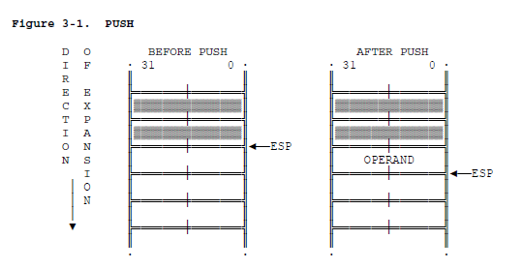
PUSH
PUSH (Push) decrements the stack pointer (ESP), then transfers the source operand to the top of stack indicated by ESP.
PUSH AX

Slide 13
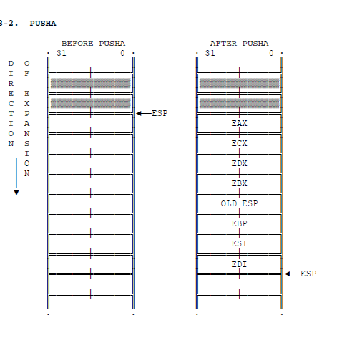
PUSHA
PUSHA (Push All Registers) saves the contents of the eight general registers on the stack.
PUSHA

Slide 14
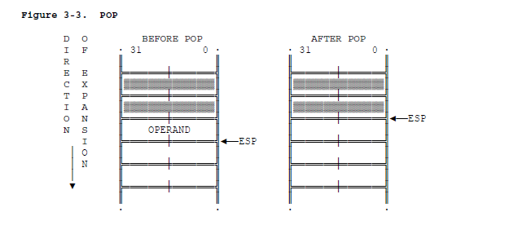
POP
POP (Pop) transfers the word or double-word at the current top of stack (indicated by ESP) to the destination operand, and then increments ESP to point to the new top of stack.
POP AX

Slide 15
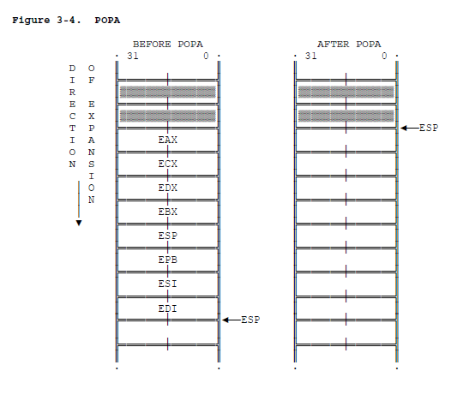
POPA
POPA (Pop All Registers) restores the registers saved on the stack by PUSHA, except that it ignores the saved value of ESP.
POPA

Slide 16
Type Conversion Instructions
The type conversion instructions convert bytes into words, words into double-words, and double-words into 64-bit items (quad-words).
There are two classes of type conversion instructions:
The forms CWD, CDQ, CBW, and CWDE which operate only on data in the EAX register.
The forms MOVSX and MOVZX, which permit one operand to be in any general register while permitting the other operand to be in memory or in a register.

Slide 17
CBW –Convert Byte to word
This instruction copies the sign bit in AL to all the bits in AH.AH is then said to be sign extension of AL.
Algorithm-
If MSB bit of AL=1 then AH =255 (FFH) else AH=0

Slide 18
CWD(Convert Word to Double Word)
This instruction copies sign bit of word in AX to all the bits of DX register. DX is sign extension of AX then.
CWD

Slide 19
CWDE (Convert Word to Double Word Extended)
This instruction copies sign bit of AX to all the bits in the EDX:EAX register pair.
EAX is then signed extension of AX register.

Slide 20
CDQ
Convert double word to quad word
This instruction copies the sign bit of EAX to all the bits in EDX register.
EDX is then signed extension of EAX register.
If MSB bit of EAX =1 then EDX=FFFFFFFF else EDX=0000000

Slide 21
MOVSX
MOVSX (Move with Sign Extension) sign-extends an 8-bit value to a 16-bit value and a 8- or 16-bit value to 32-bit value.
MOVSX EAX,BL
This instruction copies the content of BL register to EAX register. The sign bit the 7th bit of BL register is copied to the MSB of EAX register.

Slide 22
MOVZX
Move with zero extended
MOVZX EAX,BL
This instruction copies the content of BL register to EAX register. Zero is copied to the MSB of the EAX register as well as the AH register.

Slide 23
Binary Arithmetic Instruction
The arithmetic instructions of the 80386 processor simplify the manipulation of numeric data that is encoded in binary. Operations include the standard add, subtract, multiply, and divide as well as increment, decrement, compare, and change sign.
Both signed and unsigned binary integers are supported.
Many of the arithmetic instructions operate on both signed and unsigned integers.

Slide 24
Binary Arithmetic Instruction
These instructions update the flags ZF, CF, SF, and OF in such a manner that subsequent instructions can interpret the results of the arithmetic as either signed or unsigned.
CF contains information relevant to unsigned integers; SF and OF contain information relevant to signed integers. ZF is relevant to both signed and unsigned integers; ZF is set when all bits of the result are zero.

Slide 25
Binary Arithmetic Instruction
Addition
ADD
ADC
Subtraction
SUB
Multiplication
MUL
INC
SBB
DEC
IMUL

Slide 26
Binary Arithmetic Instruction
Division
DIV
IDIV
Comparison and
Sign Change
NEG
CMP

Slide 27
Addition
Add desitination,source
ADD BL,CL
BL=BL+CL
This instruction can not be used to add the content of two memory locations.
Source and destination both have to be same types. i.e. byte or word.
The add instruction does not distinguish between signed and unsigned operands. Instead the processor evaluate the result for both data types and sets the OF and CF flags to indicate a carry in signed or unsigned result respectively.
The SF flag indicate the sign of signed result.

Slide 28
ADC
Add with carry
Destination=destination +source + CY
ADD AL,BL
This instruction adds destination operand contents , source operand contents and carry flag and result is stored back to destination operand.
AL=AL+BL+CY

Slide 29
INC
Increment byte, word or double word by 1.
INC CX
INC AL
INC EBX
Add 1 to the content of register.
Destination=Destination+1

Slide 30
SUB
Subtract Byte or word
SUB BL,CL
BL=BL-CL
SUB AX,[2048]
AX=AX- Content of memory location

Slide 31
SBB
Subtract byte or word or double word with borrow
SBB AL,BL
AL=AL-BL-CY
This instruction subtract source and carry flag(borrow) from destination. They can be signed or unsigned binary numbers.

Slide 32
DEC
Decrement byte or word or double word
Decrement destination by one
DEC AL
AL=AL-1

Slide 33
MUL
Performs unsigned multiplication
This instruction multiplies
MUL CX
DX:AX=CX*AX
The result of multiplication MSB will be stored in DX and LSB will be stored in AX register.

Slide 34
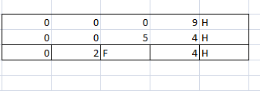

Example- AX- 009H * CX MUL CX:

Slide 35
IMUL
Multiply Byte or Word or Double Word Signed
Example
IMUL BL
Let AL 0100 0101=45H
BL 00001110=0EH
45H Content of AL register
*0E H Content of BL register
03C6H Result of Multiplication
AX=03C6H DX=0000 H
MSB=0
So SF=0,CF=OF=1
SF-Sign Flag CF-Carry Flag
OF-Overflow Flag

Slide 36
DIV
Divide an unsigned word by a byte.
The word must be in AX register.
After division
AL- 8 bit quotient
AH -8 bit remainder
Example- DIV BH
AX/BX
AX-Divident
BX-Divisor
AL-Quotient =5EH
AH-Remainder-65H
All flags are undefined.

Slide 37
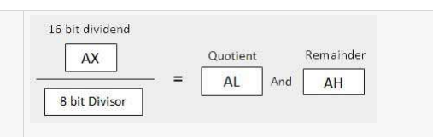
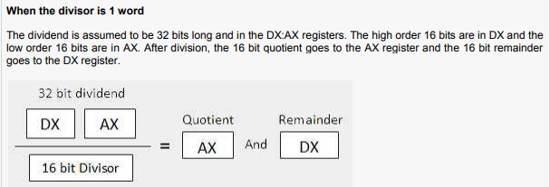
DIV

Slide 38
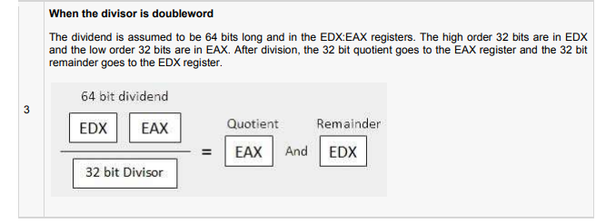
DIV

Slide 39
IDIV
A signed word is divided by a signed byte
Example AX=03ABH
BL=D3H
IDIV BL
Quotient in AL= ECH
Remainder in AH =27H

Slide 40
Difference
The main difference between MUL and IMUL instruction is that IMUL operates on signed data.
The main difference between DIV and IDIV instruction is that IDIV operates on signed data.

Slide 41
Comparison and Sign Change
NEG(Negative Byte or Word or Double Word)
CMP(Compare Byte or Word or Double word)

Slide 42
NEG
NEG(Negative Byte or Word or Double Word)
Performs 2’s complement negation of the destination
NEG AX
Operation-
NEG Performs 2’s complement negation of the destination
The 2’s complement is obtained by adding 1 to 1s complement of that number.
It is useful for changing sign of a signed word or byte.
An attempt to negate a byte that contains -128 or a word that contains -32,768 will result in no change and overflow flag is set.
SF,ZF,OF,CF and AF and PF flags are affected.

Slide 43
CMP
Compare Byte or word or double word
CMP BH,CL
CMP Desination,Source
The comparison is done by subtracting source from destination.
The result is not stored in either source or destination only flags are updated.
Both source and destination operand must be of same type.
Compare | CF | ZF | SF
Source>Destination | 1 | 0 | 1
Source<Destination | 0 | 0 | 0
Source=Destination | 0 | 1 | 0

Slide 44
Logical Instructions
Boolean operation Instructions
NOT
AND
OR
XOR

Slide 45
NOT
Not byte word or double word
NOT Destination
Algorithm-
If bit is 1 turn it to 0
If bit is 0 turn it to 1
NOT EAX
This instruction complement the contents of EAX register.

Slide 46
AND
And byte word or double word
Do logical AND operation
AND AL,BL
This instruction ANDs each bit of AL register with BL register and result is stored in AL register.
Operation
1 AND 1=1
0 AND 1=0
1 AND 0 =0
0 AND 0=0

Slide 47
OR
Logical OR of two operands
OR AL,BL
This instruction ORs each bit of AL register with BL register and result is stored in AL register.
Operation
1 OR 1=1
0 OR 1=1
1 OR 0 =1
0 OR 0=0

Slide 48
XOR
Exclusive OR BYTE or word or double word
XOR Destination, Source
XOR AL,BL
This instruction XORs each bit of AL register with BL register and result is stored in AL register.
Operation
1 XOR 1=0
0 XOR 1=1
1 XOR 0 =1
0 XOR 0=0

Slide 49
Bit Test and Modify Instruction
BT
BTS
BTR
BTC
BSF
BSR

Slide 50
BT
Bit Test
Example BT EAX,05
This instruction copies the bit 5 of the EAX register to the carry flag.
Algorithm
CF=0 if Bit =0,or
CF=1 if Bit =1
The instruction tests the status of the specified bit in the instruction .The status of that bit is copied to the carry flag.

Slide 51
BTS
Bit test and Set
Algorithm-
CF=0 if Bit =0,and then bit=1
CF=1 if Bit =1
This instruction test the status the specified bit in the instruction. The status of that bit is copied to the carry flag and then bit is set.
BTS EAX,05
This instruction copies the bit 5 of EAX register to carry flag.
and then BIT 5 of the EAX register is set.

Slide 52
BTR
Bit test and reset
Algorithm
CF=0 if bit =0
Or CF=1 if bit =1 and bit=0
This instruction test the status the specified bit in the instruction. The status of that bit is copied to the carry flag and then bit is reset.
BTR EAX,05
This instruction copies the bit 5 of EAX register to carry flag.
and then BIT 5 of the EAX register is reset.

Slide 53
BTC
Bit test and Complement
Algorithm
CF=0 if bit =0 then complement the bit
Or CF=1 if bit =1 then complement the bit
This instruction test the status the specified bit in the instruction. The status of that bit is copied to the carry flag and then bit is complemented.
BTC EAX,05
This instruction copies the bit 5 of EAX register to carry flag.
and then BIT 5 of the EAX register is complemented i.e. Bit5=0 then Bit5=1.

Slide 54
Shift Instruction
In the shift we will shift either by a constant 1 or depending upon CL register(this register is default register of shift operation).
SHL/SHA
SHR
SAR
SHLD
SHRD

Slide 55
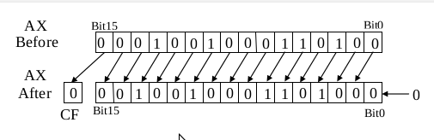
SHL/SAL
Shift logical/arithmetic left byte or word or double word
SAL/SHL Destination, Count
SAL/SHL are two mnemonics for same instruction.
This instruction shift each bit of specified destination ,some number of bit position to left. As left bit is shifted out of the LSB position ,0 is put in the LSB position. The MSB will be shifted to the CF.
Operation CF<- MSB<- LSB<-0

Slide 56

SHR
Shift Right
Shift all bit right the bit that goes off is set to CF. Zero bit is increased to the right most position.
For multi bit shift CF will contain bit most recently shifted out from LSB position.
Example- SHR AX,CL

Slide 57
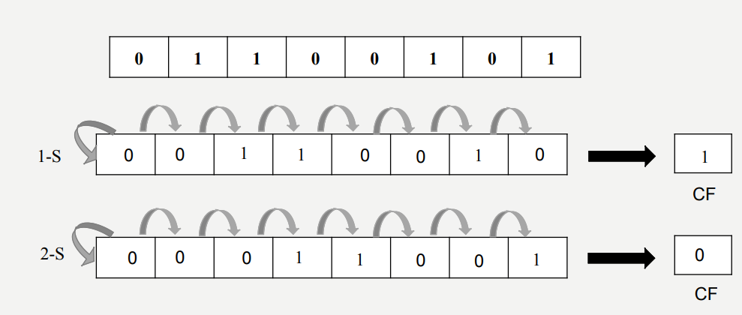
SAR
Shift Arithmetic right byte or word or double word.
The SAR instruction (shift arithmetic right) operates like SHR, with one difference: the MSB retains its original value.

Slide 58
SHLD and SHRD
SHLD- Shift Left double Precision
This instruction is used to shift specified number of bits left from one operand to another operand.
The source operand is a register.
The destination can be register or memory location.
Example –
SHLD EAX,ECX,3
This instruction shift upper 3 bits from ECX into lower 3 bits of EAX.

Slide 59
SHRD
SHLD- Shift right double Precision
This instruction is used to shift specified number of bits right from one operand to another operand.
The source operand is a register.
The destination can be register or memory location.
Example –
SHLD EAX,ECX,3
This instruction shift lower 3 bits from ECX into lower 3 bits of EAX.

Slide 60
Rotates
ROL
ROR
RCL
RCR

Slide 61
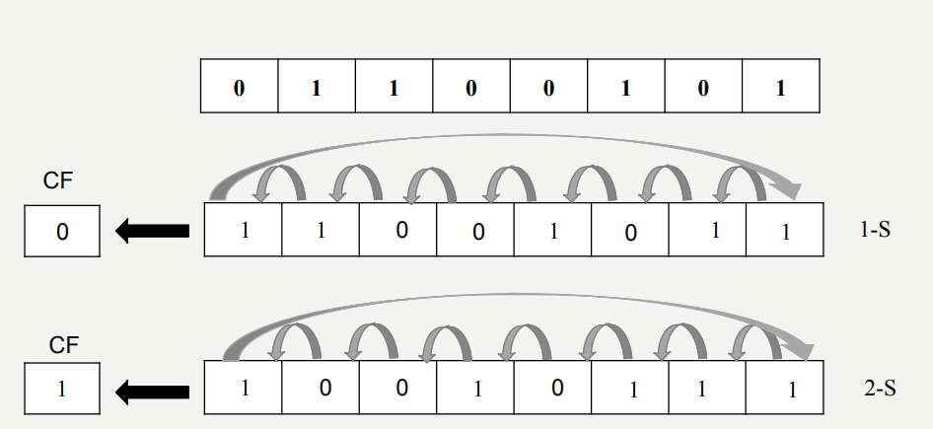
ROL
Roate Left
ROL Destination,Source
The instruction ROL (rotate left )shifts bits to the left .The msb is shifted into the rightmost bit . The CF also gets the bit shifted out of the msb .
ROL AX,02H

Slide 62
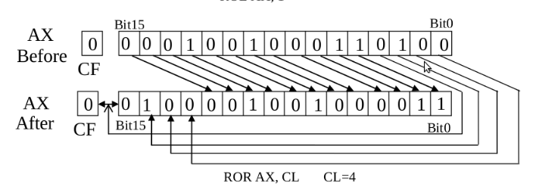
ROR
Rotate Right
The instruction ROR (rotate right ) works just like ROL , except that the bits are rotate to the right .The rightmost bit is shifted into the MSB , and also into The CF.

Slide 63
Test Instruction
TEST-Byte ,Word or Double Word
Test dest, src –
Performs (dest) AND (src) logical AND of two operands. - Flags are updated. - Result is not saved.
Flags are affected .
CF=0, OF=0,
PF, SF, ZF Flags reflect the result.
The TEST instruction works same as the AND operation, but unlike AND instruction, it does not change the first operand. So, if we need to check whether a number in a register is even or odd, we can also do this using the TEST instruction without changing the original number.
TEST AL, 01H
JZ EVEN_NUMBER

Slide 64
Control Transfer Instruction
The instructions that controls the program flow or allow changes in program flow are called as branch instruction or program control instruction.
Genrally after execution of TEST or CMP instruction decision is made to change flow of program.
Unconditional Jump
Conditional Jump
Subroutine Call ,Return

Slide 65
JUMP-Conditional
No high-level control structures in assembly language The most common way to transfer control in assembly language is to use a conditional jump.
This is a two-step process:
1. First test the condition.
2. Then jump if the condition is true or continue if it is false.
Conditional jump instructions can be divided into four groups:
3. Jumps based on the value of a single arithmetic flag
4. Jumps based on the value of CX or ECX
5. Jumps based on comparisons of signed operands
6. Jumps based on comparisons of unsigned operands

Slide 66
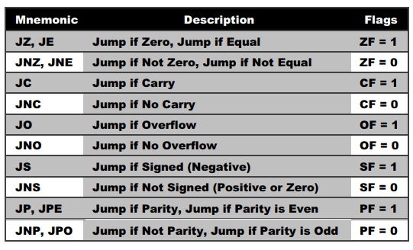
Jump Condition
Conditional Jump Instruction
Jcond destination ; cond is the jump conditiontion has the following syntax:

Slide 67
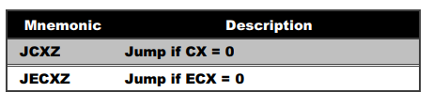
The following table shows the jumps based on the value of CX and ECX:

Slide 68
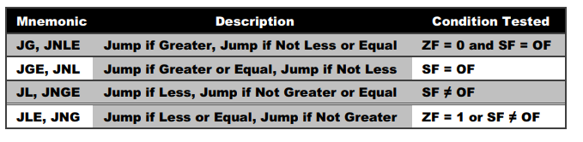
Jump Condition
The Following table shows a list of signed jumps based on comparisons of signed Operands:

Slide 69
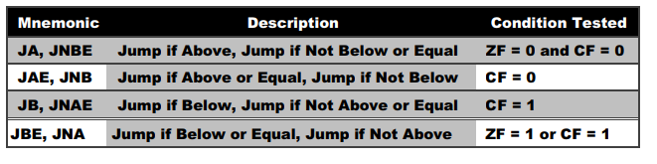
Jump Condition
The following table shows a list of signed jumps based on comparisons of unsigned operands:

Slide 70
Unconditional
JMP, CALL, RET, INT and IRET instructions transfer control from one codesegment location to another.
These locations can be within the same code segment (near control transfers) or in different code segments (far control transfers). The variants of these instructions that transfer control to other segments are discussed in a later section of this chapter. If the model of memory organization used in a particular 80386 application does not make segments visible to applications programmers, intersegment control transfers will not be used.
The JMP instruction is the only unconditional flow control instruction
It unconditionally transfers control to another point in the program
The location to be transferred to is known as the target address

Slide 71
Jump Instruction: JMP
The JMP instruction is the only unconditional flow control instruction
It unconditionally transfers control to another point in the program
The location to be transferred to is known as the target address

Slide 72
Jump Instruction
Syntax:
JMP destination
Destination is a label in the same segment as the JMP.
JMP can be used to get around the range restriction of a conditional jump

Slide 73
CALL Procedure
This Instruction is used to transfer execution to a subprogram or procedure. There are two basic types of CALL ’s :
A Near CALL is a call to a procedure which is in the same code segment as the CALL instruction .
Direct within-segment ( near or intrasegment )
CALL MULTO ;
MULTO is the name of the procedure. The assembler determines displacement of MULTO from the instruction after the CALL and codes this displacement in as part of the instruction .

Slide 74
Return and Return-From-Interrupt Instruction
RET (Return From Procedure) terminates the execution of a procedure and transfers control through a back-link on the stack to the program that originally invoked the procedure. RET restores the value of EIP that was saved on the stack by the previous CALL instruction.

Slide 75
Loop Instruction
The loop instructions are conditional jumps that use a value placed in ECX to specify the number of repetitions of a software loop.
All loop instructions automatically decrement ECX and terminate the loop when ECX=0.Four of the five loop instructions specify a condition involving ZF that terminates the loop before ECX reaches zero.
Loop Instruction-
LOOPE (Loop While Equal) and LOOPZ (Loop While Zero)
LOOPNE (Loop While Not Equal) and LOOPNZ (Loop While Not Zero)

